Slide 1
Comprehensive VHDL Hamdi Abdelbagi Phone: (937) 830-7761 Email: abdelbagih1@udayton.edu

Slide 2
Synthesising Combinational Logic
Aim
To understand the basic sequential statements, and synthesis of combinational
Topics covered
If statements
Conditional signal assignments
Equivalent process
Transparent latches
Case statement
Synthesis of combinational logic

Slide 3
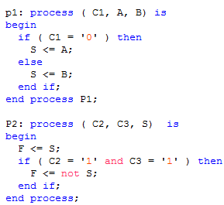
If Statements

Slide 4
Multiple and Nested Statements

Slide 5
Elsif

Slide 6
Conditional Signal Assignment
Concurrent statement equivalent to the previous slide
The can only be one target for the statement

Slide 7
Equivalent Process
Concurrent signal assignment
Equivalent process

Slide 8
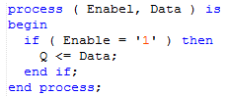
Transparent Latches
Incomplete assignment infers a transparent latch
Often mistake - check your syntheses report

Slide 9
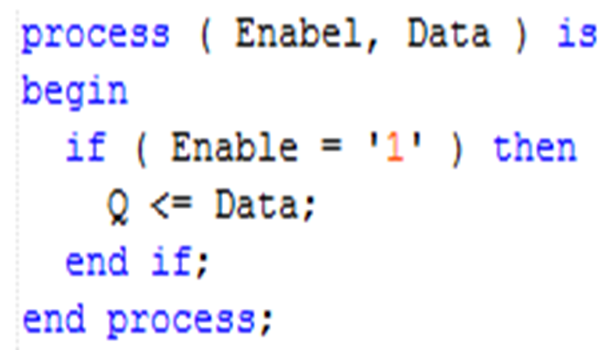
FPGAs and Transparent Latches

Slide 10
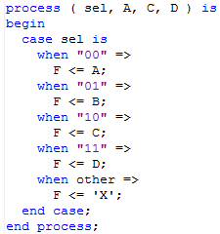
Case Statements

Slide 11
Case Statement Options

Slide 12
Synthesis of Combinational Logic

Slide 13
Type
Aim
To understand the characteristic of INTEGER, STD_LOGIC, STD_LOGIC_VECTOR type
Topics covered
VHDL type
Standard packages
INTEGER subtype
Type STD_LOGIC, STD_LOGIC_VECTOR
Slice and concatenation
Integer and vector values

Slide 14
VHDL Data Type

Slide 15
Standard Packages

Slide 16
Integer Subtype

Slide 17
Multi-valued

Slide 18
STD_LOGIC_VECTOR

Slide 19
Initial Values
Signals are initialized at the start of simulation
Default value is the leftmost value of the type
Synthesis ignores initial values (except constants)

Slide 20
Slice Names

Slide 21
Concatenation
Concatenation operation &

Slide 22
Shifting

Slide 23
Comparing Vectors
Beware: STD_LOGIC_VECTOR are not numbers
Comparison is done purely by order of the values in std_logic

